Slide 1
Digital Portfolio
asunm161212400950
STUDENT NAME:
REGISTER NO AND NMID:
DEPARTMENT:
COLLEGE: COLLEGE/ UNIVERSITY
J. KISHORE NANDAKUMAR
212400950 and 21CCDB4D343BAD695CF452135F371E16
Bachelor of computer applications
Prince shri venkateshwara arts and science college/Madras university

Slide 2
PROJECT TITLE
J.Kishore-Nanda-Kumar--Repository

Slide 3


AGENDA
Problem Statement
Project Overview
End Users
Tools and Technologies
Portfolio design and Layout
Features and Functionality
Results and Screenshots
Conclusion
Github Link
3/21/2024 Annual Review

Slide 4

PROBLEM STATEMENT
Students often find it difficult to present their skills, education, and certifications in an engaging way using only resumes.
To solve this, I created a personal portfolio website that
highlights my background, skills, and achievements in a clear,
professional, and accessible format.

Slide 5

PROJECT OVERVIEW
This project is a personal portfolio website designed to showcase
my academic background, skills, and certifications in a professional and organized manner. It serves as an online resume where recruiters, mentors,
and collaborators can easily learn about me. The website
includes sections such as About Me, Education, Skills, and Certifications,
with a clean and responsive design for better accessibility.

Slide 6

WHO ARE THE END USERS?
Recruiters & Employers to evaluate your skills, education, and certifications for internships or jobs. College Professors & Mentors to review your progress and academic journey. Peers & Collaborators – students or developers who may want to connect or work with you. Clients (future) – if you do freelance or project-based work. You (Yourself) – to maintain a professional digital presence and track your own growth.

Slide 7

TOOLS AND TECHNIQUES
HTML5 – to structure the content of the portfolio. CSS3 for styling, layout, and responsive design. JavaScript (optional) to add interactivity and dynamic features. Code Editor (VS Code / Sublime Text /Notepad++) for writing and editing code. Browser (Chrome / Edge / Firefox) – for testing and running the website. Version Control (GitHub, optional) – to host and manage the portfolio online.

Slide 8
POTFOLIO DESIGN AND LAYOUT
Header / Introduction – Displays name, age, and a short introduction. 2. About Me – Brief details about education and career aspirations. 3. Education – Academic details and current course (BCA). 4. Skills List of technical skills (e.g., beginner in Python).
Responsive design for desktop and mobile. Consistent color scheme and typography. Organized sections for easy access. Minimalistic, professional look to highlight content.
8

Slide 9
FEATURES AND FUNCTIONALITY
1. About Section – Provides a brief introduction about me. 2. Education Section Displays academic details in a structured format. 3. Skills Section – Lists technical skills with beginner/advanced levels. 4. Certifications Section – Highlights courses and achievements. 5. Responsive Design Works smoothly on both desktop and mobile devices. 6. Clean Navigation – Simple scrolling or menu-based navigation for easy access. 7. Attractive Layout – Humanized design with proper colors, fonts, and spacing.

Slide 10
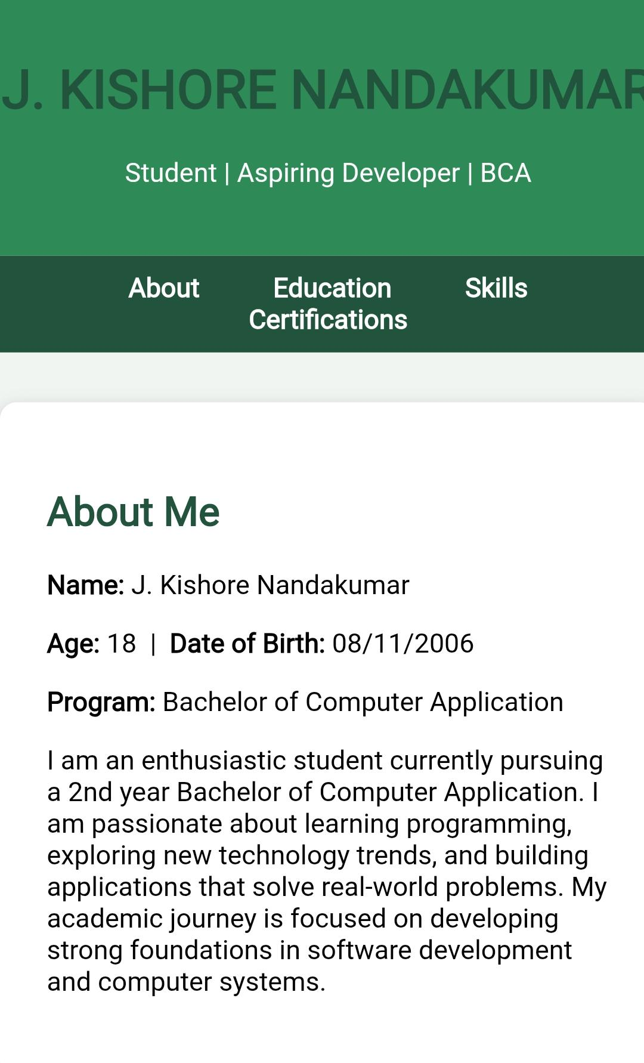

RESULTS AND SCREENSHOTS
3/21/2024 Annual Review
10

Slide 11
Git hub link
https://kishore-0811.github.io/J.Kishore-Nanda-Kumar--Repository-/

Slide 12
CONCLUSION
The development of this personal portfolio website successfully provides a professional platform to present my academic background, skills, and certifications in an organized manner. Unlike a traditional resume, the portfolio offers a dynamic and visually appealing way to showcase my profile to recruiters, mentors, and collaborators. The project helped me enhance my knowledge of HTML, CSS, and web design principles, while also improving my ability to create user-friendly layouts. Overall, this portfolio not only strengthens my digital presence but also acts as a foundation that can be expanded in the future by adding new features such as projects, contact forms, and downloadable resumes.
12

